Slide 1
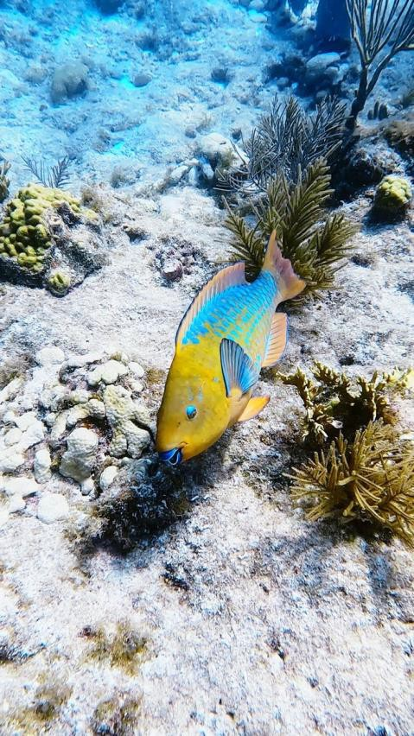
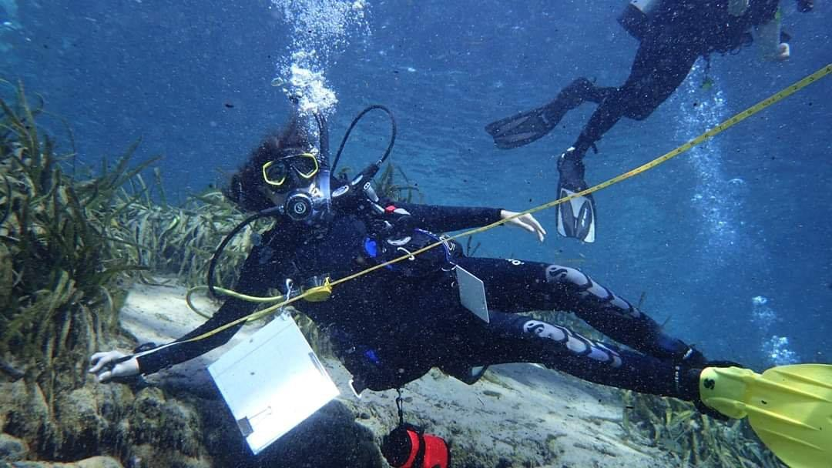
Girl Scout Gold Award Project
“Diversity of Fish in Protected and Unprotected Reefs”
Maya Barboza, March 2023

Slide 2
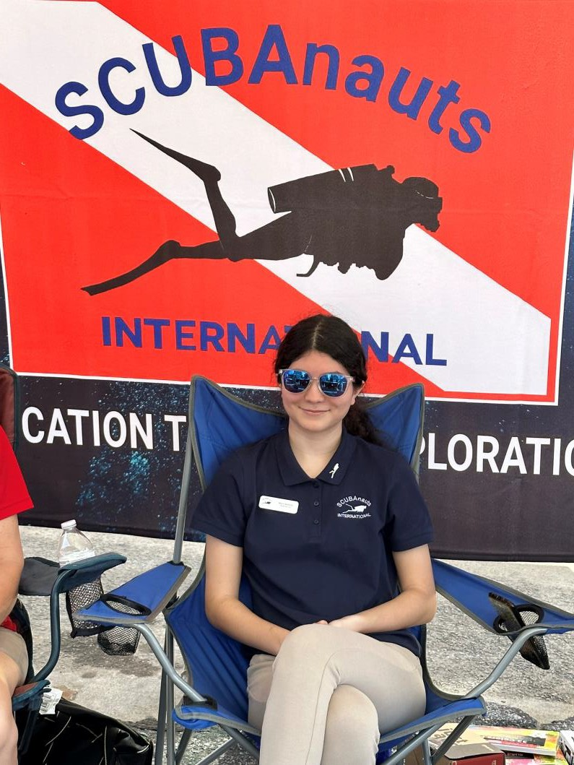
About me
Started diving a little more than 3 years ago:
Open Water certified April 2021
Advanced Open Water certified October 2022
Rescue Diver certified September 2023
Certified Scientific Diver
First Aid and CPR certified through Divers Alert Network (DAN)
Have logged almost 70 dives
Deepest dive: 100 feet (West Palm Beach, FL) 2 night dives (not my favorite)

Slide 3
Fish ID Project
Objective: Is there a noticeable difference in fish diversity between un-protected vs protected reefs?
(protected: no fishing allowed)
Hypothesis: Due to the protection from fishing, the protected reefs should have more fish diversity
Impact: Determine and track the impact that fishing has on the health of reefs by examining the fish diversity between protected reefs and unprotected reefs

Slide 4
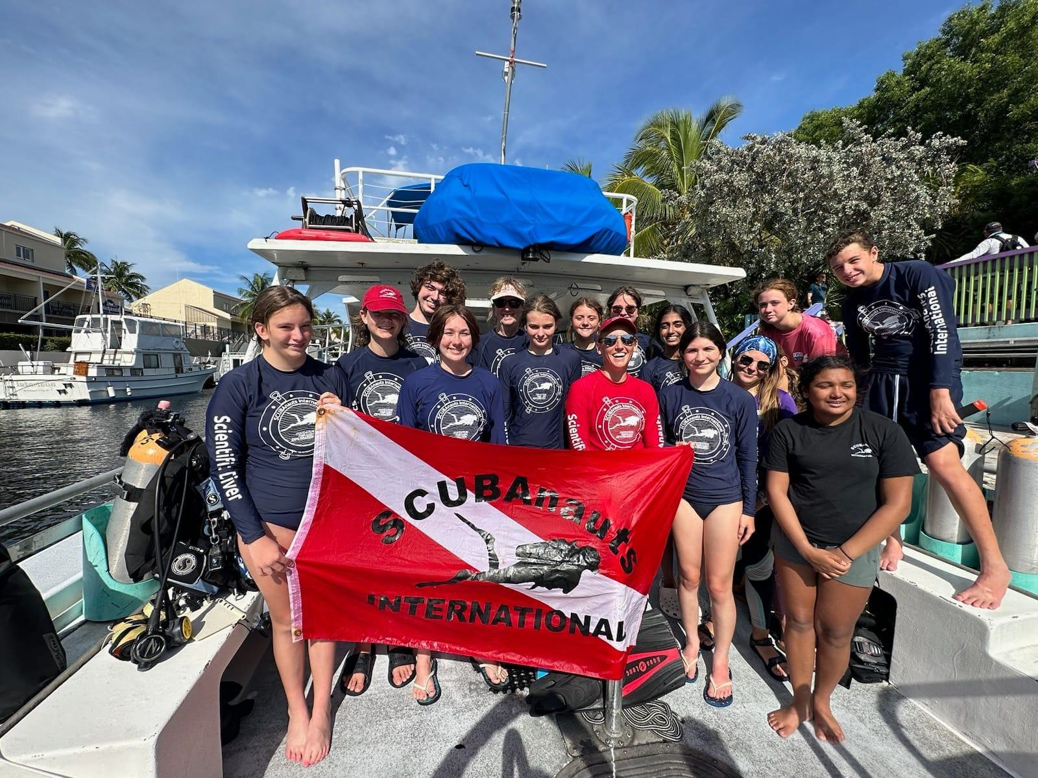
SCUBAnauts Key Largo Dive Trip
June 11-18, 2023
Fish ID Project Team:
Maya Barboza (Science Lead)
Audrey (Dive Lead) Hannah
Bibiana Graham Owen

Slide 5
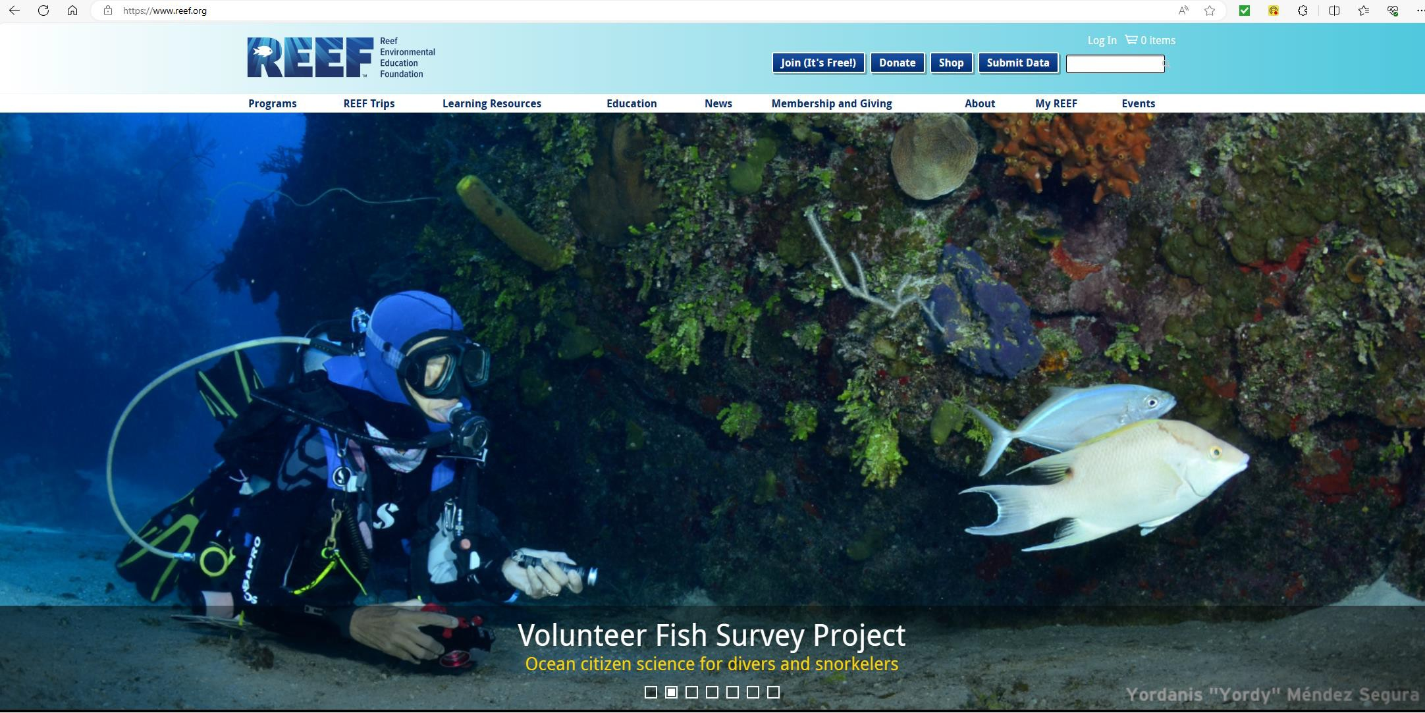
Fish ID Project
Nauts required to pass a REEF Fish Identification test to participate in dives
Data entered in REEF database and used by scientific community

Slide 6
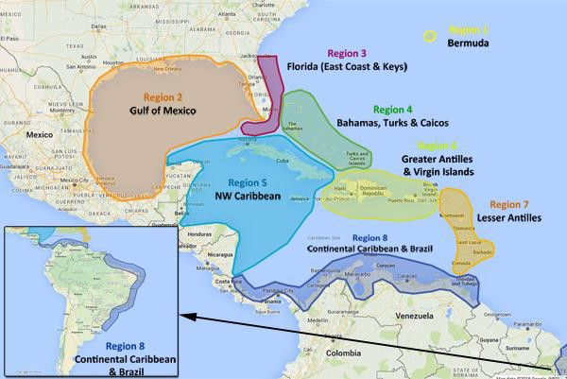
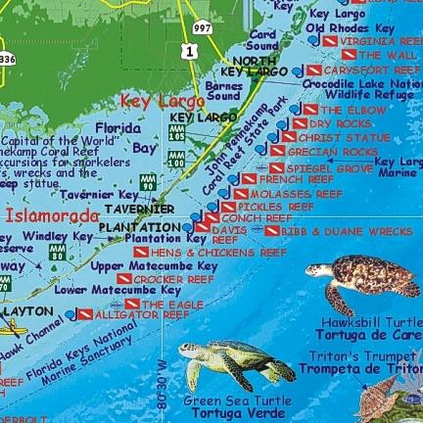
Fish ID Project, Key Largo Dive Trip
Dive Location: Key Largo
Area: Tropical Western Atlantic (TWA) Region 3: Florida (East Coast & Keys)
Dive Sites:
Christ of the Abyss French Reef Molasses Reef Pickles Reef** Snappers Ledge** Benwood (wreck)
** un-protected reefs

Slide 7
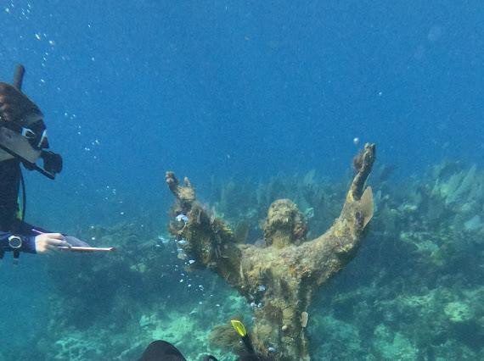
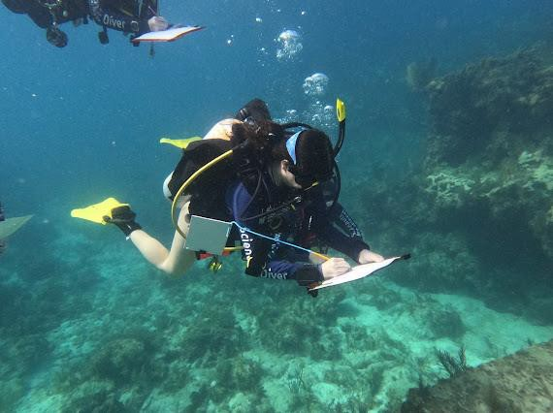
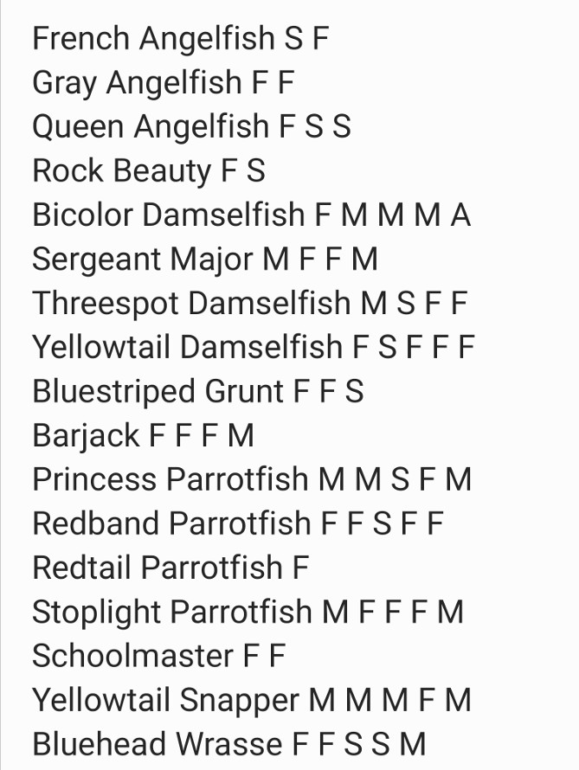
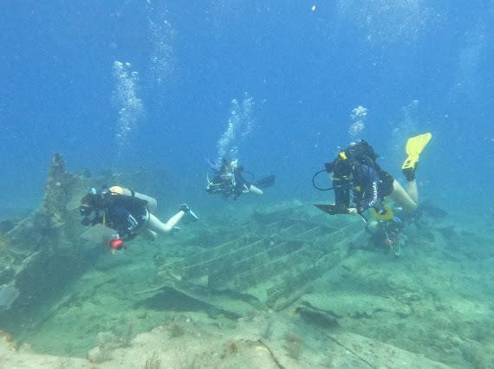
Fish ID Project, Data Collection
Example Data Sheet
0
None Single: 1
Few: 2-10
Many: 11-100
Abundant: >100
S
F
M
A

Slide 8
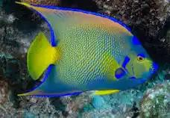
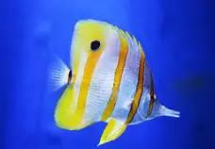
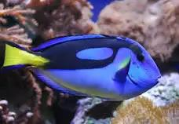
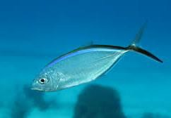
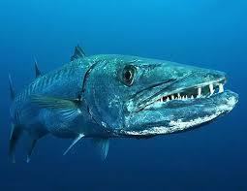
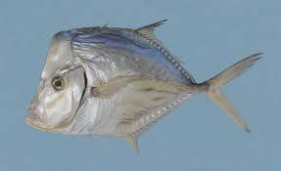
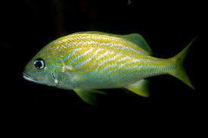
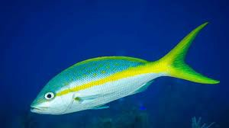
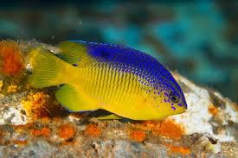
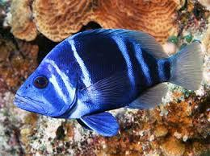
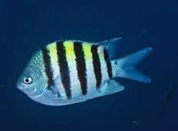
Fish ID Project, Data Evaluation
Once collected the variety of fish species identified and their abundance recorded, used Fish ID groupings to place into the 12 groups:
Group 1: Disks & Ovals, colorful (examples: angelfish, butterfly fish, surgeonfish/tangs)
Group 2: Silvery (Ex. jacks, barracuda, look-downs)
Group 3: Sloping head, tapered body (Ex. grunts, snappers)
Group 4: Small ovals (Ex. damsels, hamlets, sergeant majors)

Slide 9
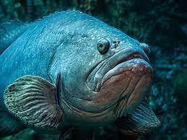
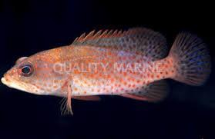
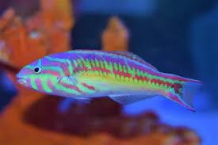
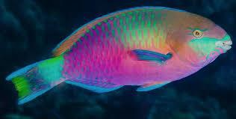
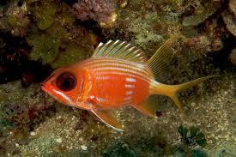
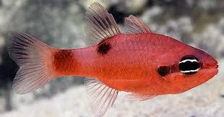
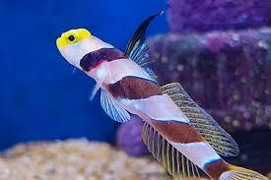
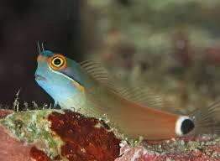
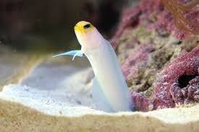
Fish ID Project, Data Evaluation
Once collected the variety of fish species identified and their abundance recorded, used Fish ID groupings to place into the 12 groups:
Group 5: Heavy bodies, large lips (Ex. groupers, basslets)
Group 6: Swim with pectoral fins, have obvious scales (Ex. wrasse, parrotfish)
Group 7: Reddish and large eyes (Ex. squirrelfish, cardinalfish)
Group 8: Small, elongated bottom-dwellers (Ex. goby, blenny, jawfish)

Slide 10
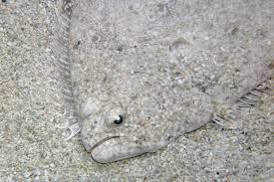
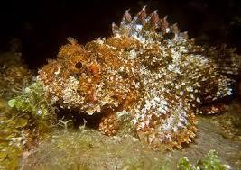
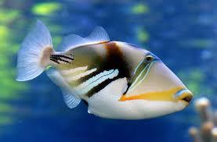
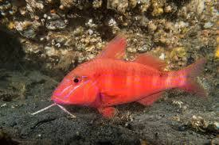
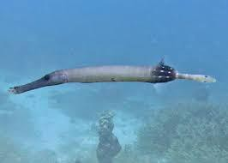
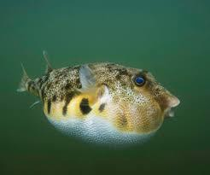
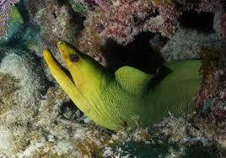
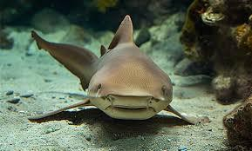
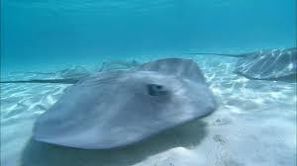
Fish ID Project, Data Evaluation
Once collected the variety of fish species identified and their abundance recorded, used Fish ID groupings to place into the 12 groups:
Group 9: Odd-shaped bottom-dwellers (Ex. flounder, scorpionfish)
Group 10: Odd-shaped swimmers (Ex. triggers, boxfish, goatfish, trumpetfish, puffers)
Group 11: Eels
Group 12: Sharks and rays

Slide 11
Fish ID Project, Data Evaluation
Unprotected Protected
Fish Group Snappers Ledge Pickels Reef Christ of the Abyss Benwood French Reef Molasses
0 None
S Single: 1
F Few: 2-10
M Many: 11-100
A Abundant: >100
Rock Beauty
1
1
1
1
1
1
1
1
1
1
1
1
1
1
1
1
1
F F
M M
F F
F F
S 0
M M
M M
F F
S 0
F F
0 F
F 0 S 0
M A M F
Bicolor Damselfish Yellowtail Damselfish Threespot Damselfish Cocoa Damselfish Blue Tang
Ocean Surgeonfish Foureyed Butterflyfish Reef Butterflyfish Branded Butterflyfish Spotfin Butterflyfish French Angelfish Blue Angelfish
Gray Angelfish Queen Angelfish
Beaugregory (damsel) Doctorfish
F F
M F
0 0
F F
F M
S M
S 0
0 0
S S
M F
M 0
0 0
M M
F F
F S
0 0
0 S
F F
0 S
F 0
0 S
0
0
0
S
0
0
0
0
0
F
Observations:
The unprotected reef, particularly Snapper’s Ledge, had more diversity in number of species and in groups of fish observed.
Questions:
0
0
F
S
0
F
0
F
S
F
M
0
0
0
0
High Hat
1
S
0
0
S
F
S
Baraccuda Bar Jack Grey Chub
Black Runner (Jack) Yellowhead Jackfish
2
2
2
2
2
S
S
0
0
0
0
M
F
F
0
0
S
M
M
M
S
M
F
M
F
M M
F
0
0
0
0
0
0
0
0
F
0
0
Blue Striped Grunt French Grunt White Grunt Smallmouth Grunt Schoolmaster Yellowtail Snapper Gray Snapper
Mohagany Snapper Glasseyed Snapper
3
3
3
3
3
3
3
3
3
A
A
M M
F F F F F
M
M
0
0
M M
M
M
M
F
M
F
M
0
M
0
F
0
F
M
M
A
M
M
A
F
M
F
0
S
0
0
S
M
0
F 0
M 0
0
0
S
Porkfish
3
0
F
0
Blue Chromis Brown Chromis Seargent Major
4
4
4
F
M
F
F
F
0
M
F
S
A
M
M
0
M
0
0
M
M
Harlequin Bass Fairy Basslet Goliath Grouper Rind Hind Grouper Graysby
5
5
5
5
5
A
M
M
A
A
M
F
F
0
0
F
0
F F
0
0
0
0
0
0
0
0
0
0
Could it be because the protected reefs are suffering and
need the protection to build them back up?
What factors could contribute to the data?
S F
0
S
0
S
0
S
0
F
0
0
Blue Parrotfish Princess Parrotfish Queen Parrotfish Midnight Parrotfish Rainbow Parrotfish Redband Parrotfish Red Tail Parrotfish Stoplight Parrotfish Striped Parrotfish Yellowtail Parrotfish Bluehead Wrasse Yellowhead Wrasse Hogfish
Spanish Hogfish Clown Wrasse Rainbow Wrasse Slippery Dick (wrasse)
6
6
6
6
6
6
6
6
6
6
6
6
6
6
6
6
6
M
M
0
F
F
S
S
F
M
M
M
F
S
M
S
F
F
0
M
S
S
S
S
F
F F
S
0
S
0
0
S M
F F F F F F F
F F
S
F 0
F M
M
0
S M
S
F
F
F
F
F
0
0
F F
M
F
F
M
S F
F
F
S
Time of day? Weather differences? Diver knowledge? Diver fatigue (first dive enthusiasm vs last dive)?
S F
F 0
S F
F F
F S
M
F
S
S 0
0
0
F 0
0
0
0
0
0
S
0
F
0
S
S M
Black Bar Soldier Squirrelfish Longspine Squirrelfish Barred Cardinalfish
7
7
7
7
0
S F F 0
0
0
0
0
0
0
0
0
F
S
S
S
M 0
S 0
0
0
S M
Bridled Goby Neon Goby Glass Goby Colon Goby Sand Diver
8
8
8
8
8
F
0
0
0
0
0
0
F
0
0
0
0
0
M
M
M
0
0
M
0
Scrawled Cowfish Honeycomb Cowfish Balloon fish Sharpnose Puffer Spotted Trunkfish Smooth Trunkfish Spotted Goatfish Yellow Goatfish Trumpet Fish Porcupinefish Ocean Triggerfish
10
10
10
10
10
10
10
10
10
10
10
0
0
M
0
F 0
0
S
0
0
0
S S
0
0
0
0
0
0
Conclusion:
It’s always good to collect more data!
F
0
0
M
M
F
F
F
F
S
F
0
0
0
S
0
0
0
S
S
0
F
0
0
0
S
0
S
0
0
A
F
S
S
F
S
F
F
F
F
0
0
0
0
0
0
S
F
0
0
S
Green Moray Eel
11
0
S
0
0
0
0
Nurse Shark
12
F
S
0
0
0
0

Slide 12
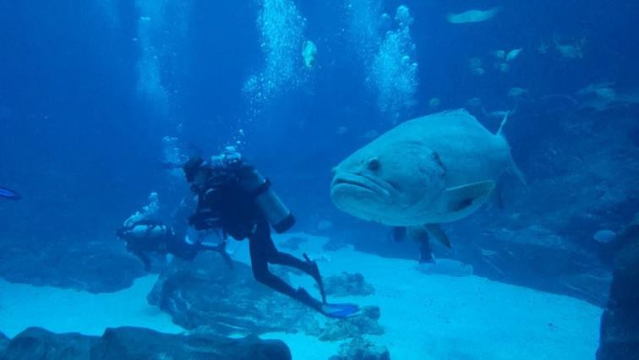
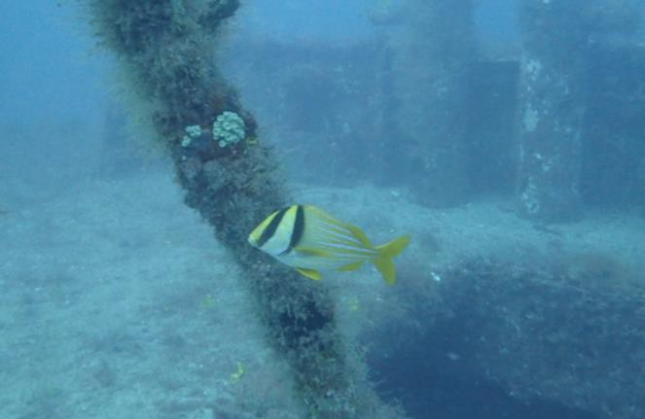
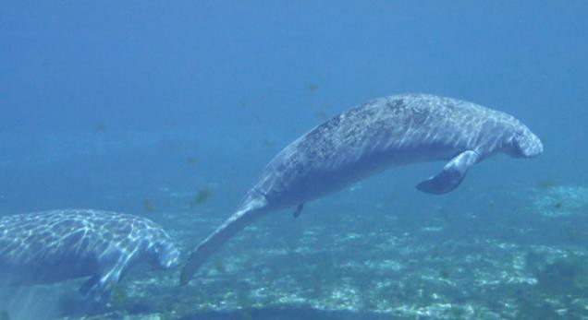
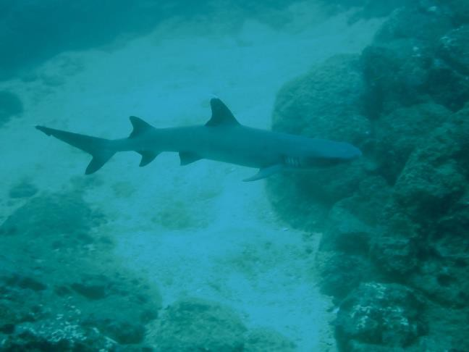
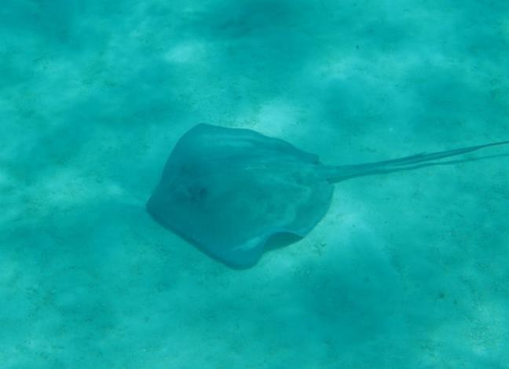
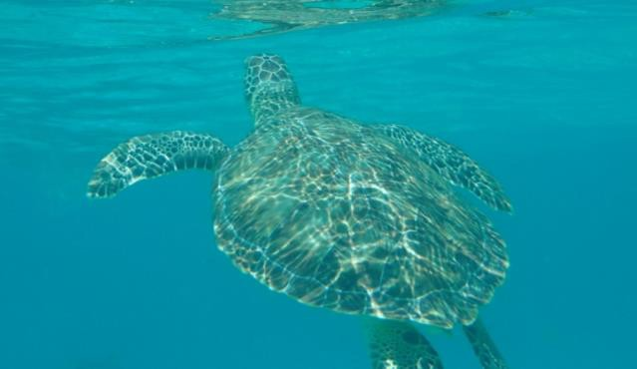
Thank you!

